Slide 1
Show me the code: Desarrollo de modelos con Deep Learning

Slide 2
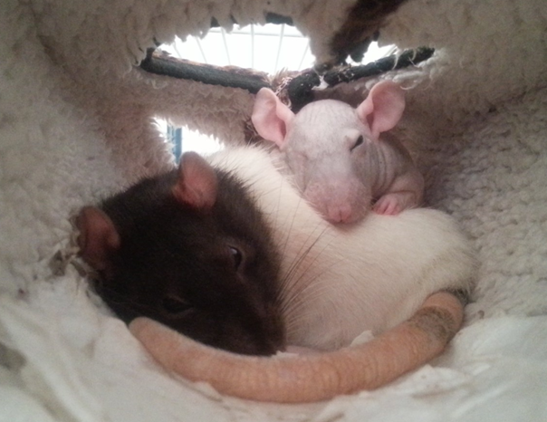
Pablo Doval
DATA PONTIFEX
I work with code and data, but don't tell my mom; she thinks I'm a piano player in a whorehouse.
@PabloDoval
palvarez@plainconcepts.com

Slide 3
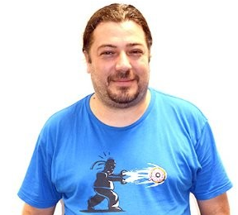
José Fernández
DATA INQUISITOR
In God we trust, others must provide data.
@jfvizoso
jfernandez@plainconcepts.com

Slide 4
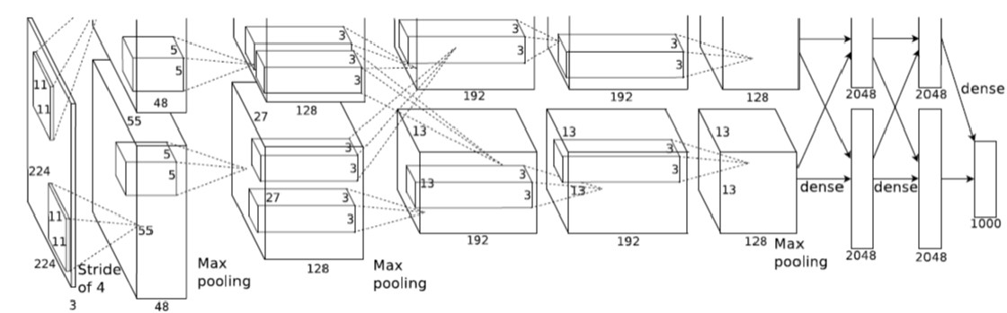
WHAT IS THIS THING?

Slide 5
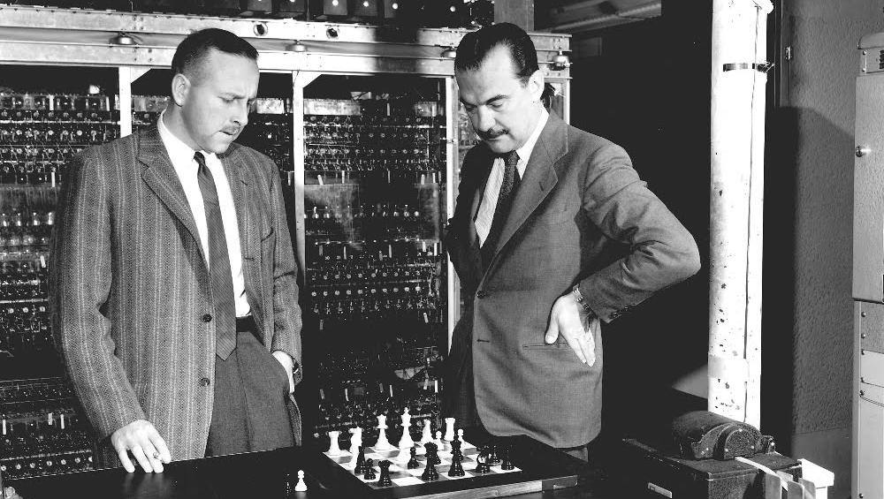
Notes:
Paul Stein and Nick Metropolis, playing chess in the MANIAC 1, in Los Alamos.
First time a human was defeated in an “intellect game”. Rule based.
They dressed way better than computer scientists today :)

Slide 6
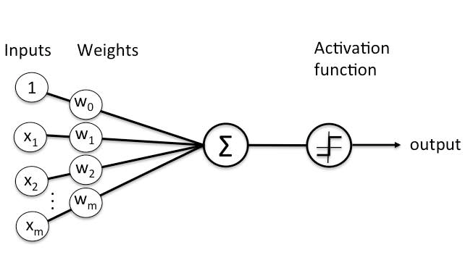
PERCEPTRON
Notes:
Frank Rossemblatt, 1956
400 photovoltaic cells as input
Weights and bias as potentiometers, electrically rotated.

Slide 7
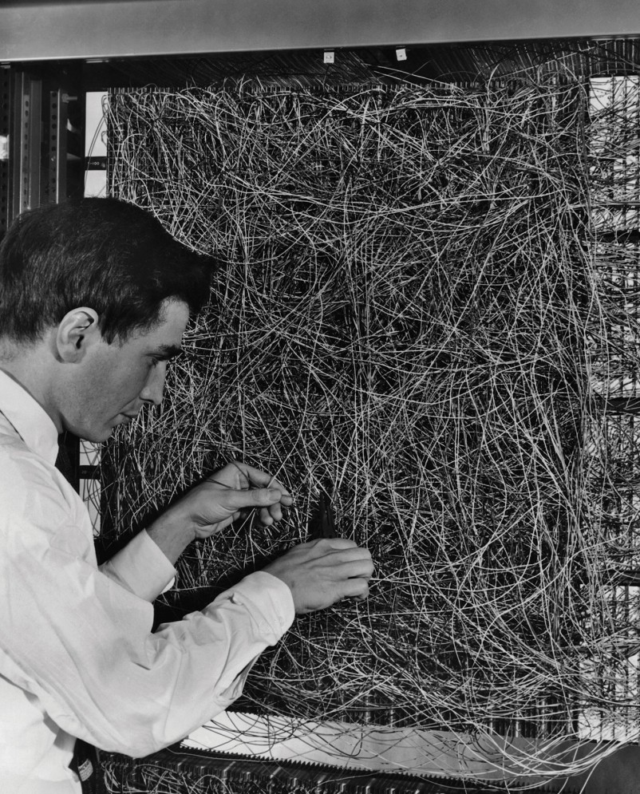
PERCEPTRON
Notes:
Frank Rossemblatt, 1956
400 photovoltaic cells as input
Wights and bias as potentiometers, electrically rotated.

Slide 8
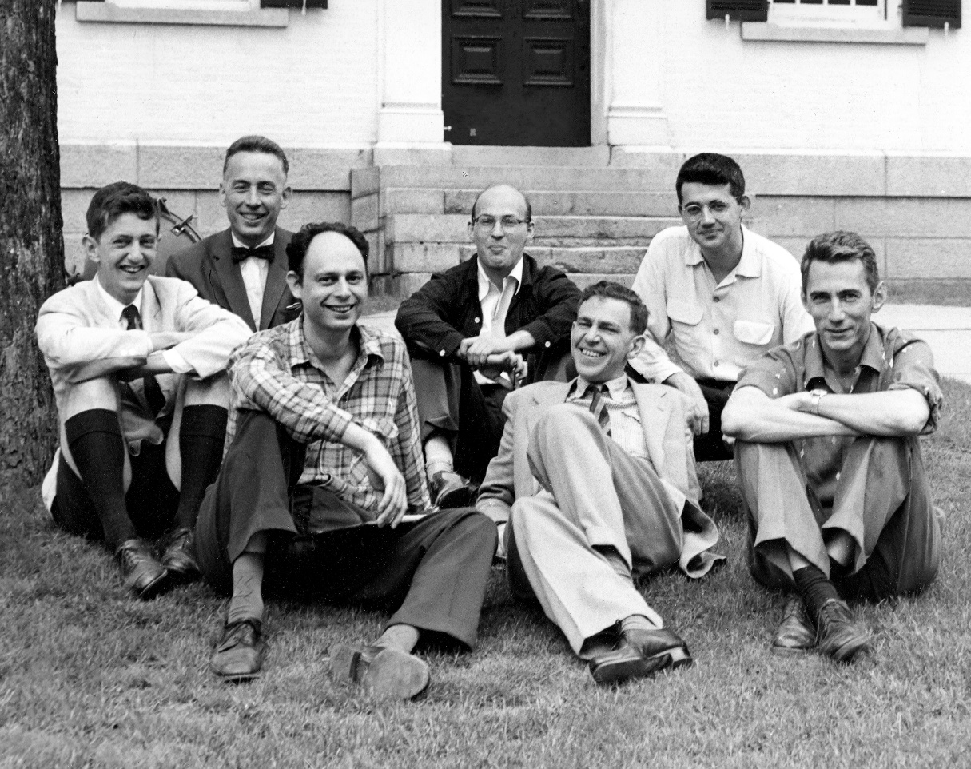
ARTIFICIAL INTELLIGENCE
Notes:
Marvin Minsky, Claude Shannon, Ray Solomonoff and other scientists
1956, Dartmouth Summer Research Project on Artificial Intelligence.
Still dressing better than today :)
Those were happy days…

Slide 9
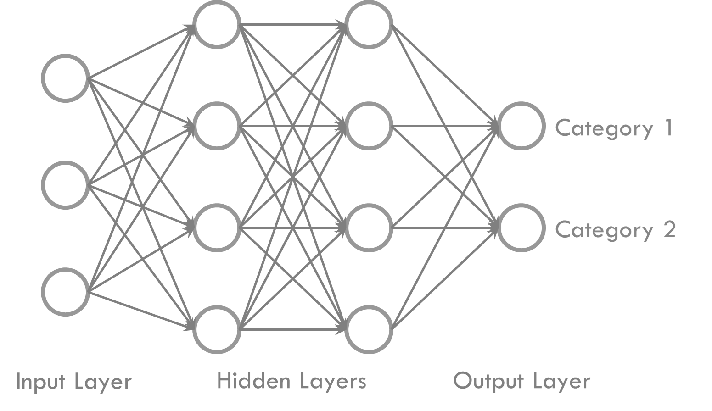
MULTILAYER PERCEPTRON
Notes:
Ivaknenko developed MLP in 1965, but…

Slide 10


Slide 11
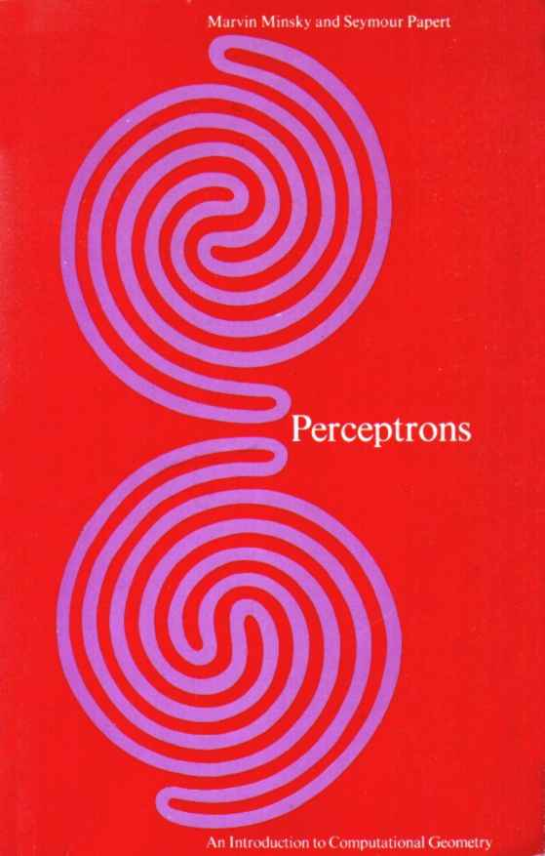
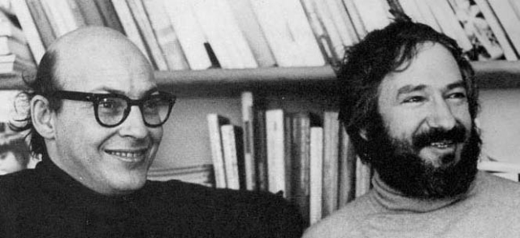
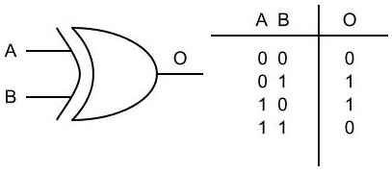
Notes:
Marvin Minksy and Seymour Papert.

Slide 12
EXPERT SYSTEMS?

Slide 13


Slide 14
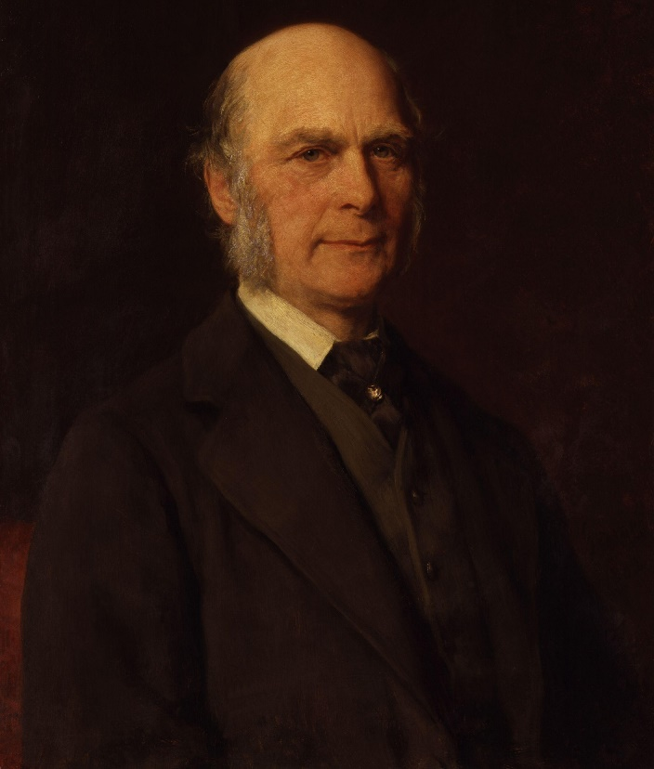
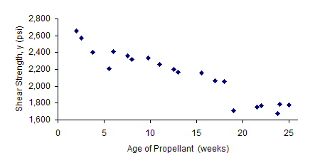
MACHINE LEARNING
Notes:
Sir Francis Galton and the linear regression.

Slide 15
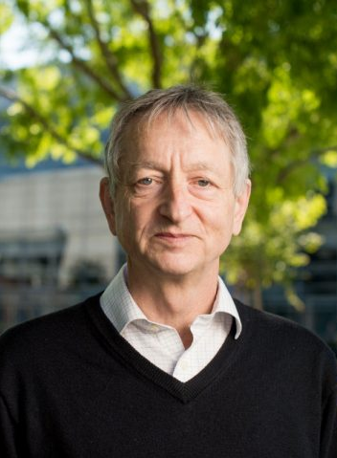
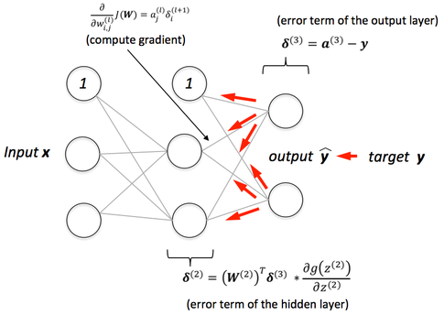
BACKPROPAGATION
Notes:
Geoff Hinton.

Slide 16
DEEP LEARNING
A Machine Learning technique

Slide 17
Image Classification
Image
Sound
Fraud Detection
Object Detection
Synthetical Generation of Images
Style Transfer
Text
Information Retrieval
Signal Analysis
Time Series Analysis
Defect Enhancement
Knowledge Extraction
Sentiment Analysis
Style Transefer

Slide 18
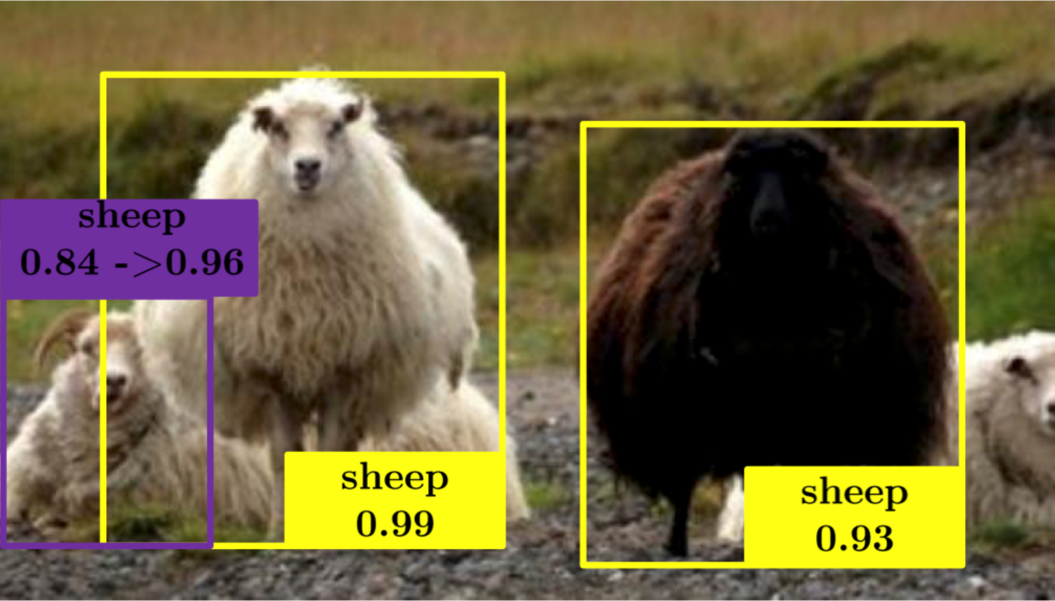

Slide 19
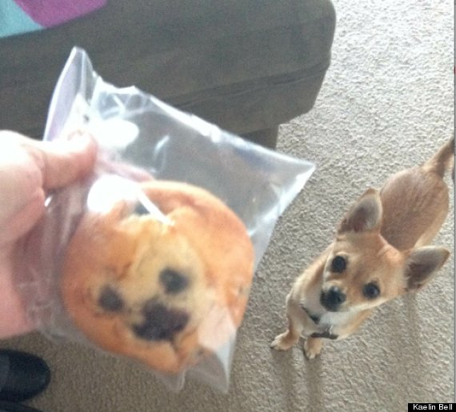

Slide 20
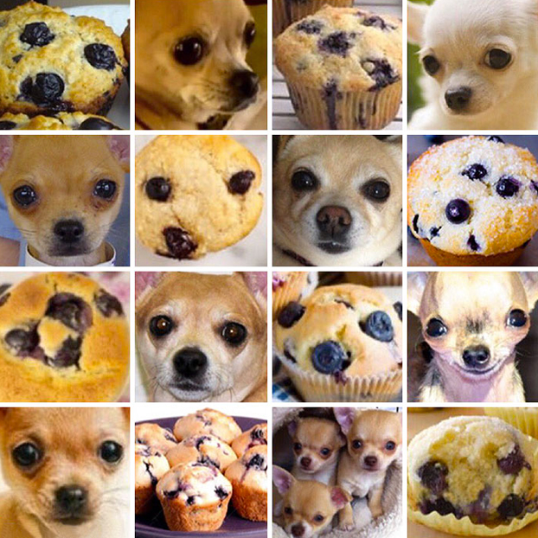

Slide 21
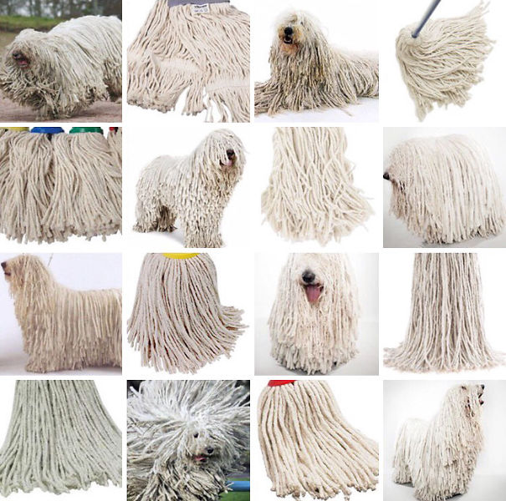

Slide 22
LAB 0: Setup

Slide 23
CHECKLIST
Anaconda
IDE
Repository
>= 5.3
Python 3.6
VS Code (or Atom, …)
Jupyter
https://github.com/PabloDoval/AITech2018
CUDA
CUDA 9

Slide 24
AI Tech 2018 Workshop – Deep Learning
Initial Setup
First of all, please do install Anaconda 5.3 in your machine
Windows version here.
Linux versión here.
MacOS X version here.
Go to the .\scripts folder and run the script that will perform the environment setup:
environment.bat (if you are running Windows)
./environment.sh (for you, Linux folks)
Once the script finishes running, that environment will be active. The name of the environment is aitech18-deeplearningworkshop, in case you want to actívate it manually.
If you plan on using GPU – and you should! – install the CUDA toolkit from this link to the NVIDIA web page.
Run the “00 - SmokeTest.py” to check that the environment and the dependencias have been properly setup. The output will show the version of the Tensorflow and Keras distribution, as well as the number of CPUs and GPUs available in your machine

Slide 25
Deep Learning with Tensorflow

Slide 26
DEEP LEARNING
Machine Learning
Based on Neural Networks
More than one hidden layer (Deep Models)

Slide 27
TensorFlow
Interface for expressing machine learning models
Why?
Multi-platform
Implementation for executing such models
Handles multiple CPUs and GPUs

Slide 28
TensorFlow
Express a numeric computation as a graph
Graph nodes are operations which have any number of inputs and outputs
Graph edges are tensors which flow between nodes
Development in Python

Slide 29
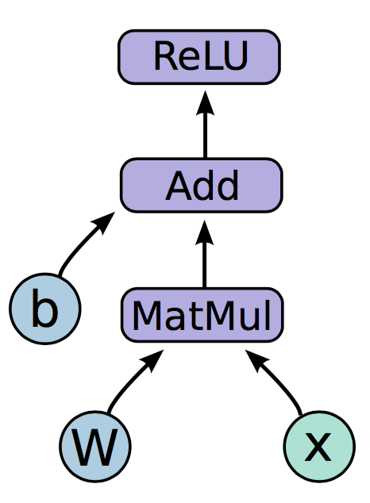
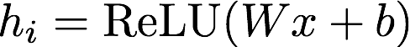
TensorFlow

Slide 30
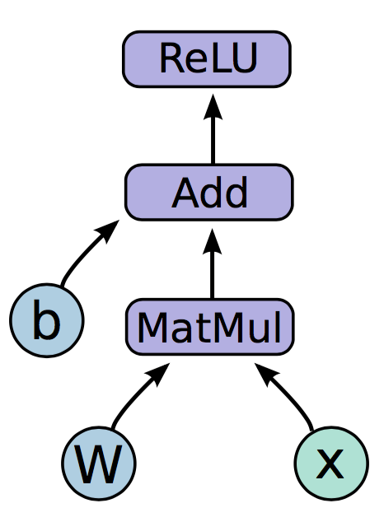
TensorFlow
Variables:
Nodes which emit their value as output
State is persisted, and retained across multiple executions of the graph
Examples: parameters

Slide 31
TensorFlow
Placeholders:
Values are fed at execution time
Examples: inputs, hyper-parameters

Slide 32
TensorFlow
Operations:
Perform the specific operation with the tensor input stream
Examples: MatMul, Add, ReLU

Slide 33
TensorFlow – Graph Code
import tensorflow as tf b = tf.Variable(tf.zeros((100,))) W = tf.Variable(tf.random_uniform((784, 100), -1, 1)) x = tf.placeholder(tf.float32, (None, 784)) h_i = tf.nn.relu(tf.matmul(x, W) + b)

Slide 34
TensorFlow – Graph Execution
Session:
Once we have defined our graph, we need to execute it
We can deploy the graph to a session
These sessions can be binded to an execution context (GPU, CPU, …)

Slide 35
TensorFlow – Execution Code
import tensorflow as tf b = tf.Variable(tf.zeros((100,))) W = tf.Variable(tf.random_uniform((784, 100), -1, 1)) x = tf.placeholder(tf.float32, (None, 784)) h_i = tf.nn.relu(tf.matmul(x, W) + b)
sess = tf.Session() sess.run(tf.initialize_all_variables()) sess.run(h_i, {x: np.random.random(64, 784)})

Slide 36
LAB 1: TensorFlow Operations

Slide 37
TensorFlow 2.0
Eager Execution as default
No need to add tf.enable_eager_execution()
Blocks or Functions can be defined to be executed in graph mode
Less conventions, more object-oriented and pythonic design
Variable_scope removed
Clean up in libraries and contrib

Slide 38
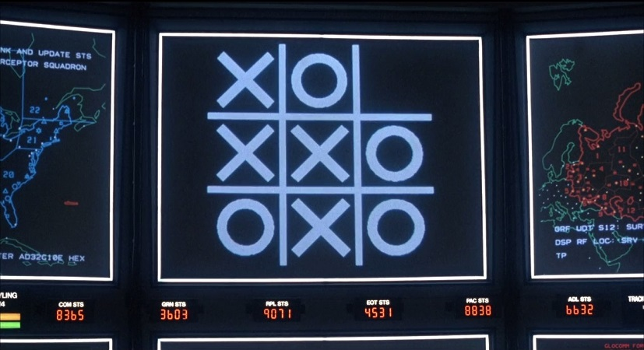
SHALL WE PLAY A LITTLE GAME?

Slide 39
A SIMPLE EXAMPLE
0 | 0 | 0 | 0 | 0 | 0 | 0 | 0 | 0
0 | 1 | 0 | 0 | 0 | 0 | 0 | 1 | 0
0 | 0 | 1 | 0 | 0 | 0 | 1 | 0 | 0
0 | 0 | 0 | 1 | 0 | 1 | 0 | 0 | 0
0 | 0 | 0 | 0 | 1 | 0 | 0 | 0 | 0
0 | 0 | 0 | 1 | 0 | 1 | 0 | 0 | 0
0 | 0 | 1 | 0 | 0 | 0 | 1 | 0 | 0
0 | 1 | 0 | 0 | 0 | 0 | 0 | 1 | 0
0 | 0 | 0 | 0 | 0 | 0 | 0 | 0 | 0
f(x)
“X”
0 | 0 | 0 | 0 | 0 | 0 | 0 | 0 | 0
0 | 0 | 0 | 1 | 1 | 1 | 0 | 0 | 0
0 | 0 | 1 | 0 | 0 | 0 | 1 | 0 | 0
0 | 1 | 0 | 0 | 0 | 0 | 0 | 1 | 0
0 | 1 | 0 | 0 | 0 | 0 | 0 | 1 | 0
0 | 1 | 0 | 0 | 0 | 0 | 0 | 1 | 0
0 | 0 | 1 | 0 | 0 | 0 | 1 | 0 | 0
0 | 0 | 0 | 1 | 1 | 1 | 0 | 0 | 0
0 | 0 | 0 | 0 | 0 | 0 | 0 | 0 | 0
f(x)
“O”

Slide 40

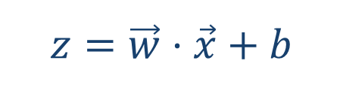
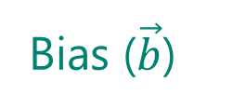
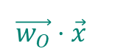
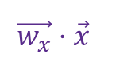
A SIMPLE EXAMPLE
81 values ($\vec{x}$)
Bias ($\vec{b}$)
…
…
1 | 0 | 0 | 0 | 0 | 0 | 0 | 0 | 0
0 | 1 | 0 | 0 | 0 | 0 | 1 | 0 | 0
0 | 0 | 1 | 0 | 0 | 1 | 0 | 0 | 0
0 | 0 | 0 | 1 | 1 | 0 | 0 | 0 | 0
0 | 0 | 0 | 1 | 1 | 0 | 0 | 0 | 0
0 | 0 | 1 | 0 | 0 | 1 | 0 | 0 | 0
0 | 1 | 0 | 0 | 0 | 0 | 1 | 0 | 0
0 | 0 | 0 | 0 | 0 | 0 | 1 | 0 | 0
0 | 0 | 0 | 0 | 0 | 0 | 0 | 0 | 0
9 pixels
Ʃ
Ʃ
9 pixels
Ʃ
Sum (weights x pixels) =
$$\vec{w_{x}}⋅\vec{x}$$
Ʃ
Sum (weights x pixels) =
$$\vec{w_{O}}⋅\vec{x}$$
$$z=\vec{w}⋅\vec{x}+b$$

Slide 41
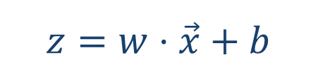
NOW THAT YOU MENTION IT…
$$z=w⋅\vec{x}+b$$

Slide 42
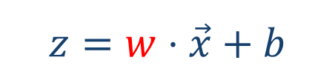
NOW THAT YOU MENTION IT…
$$z=w⋅\vec{x}+b$$

Slide 43
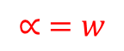
NOW THAT YOU MENTION IT…
$$z=w⋅\vec{x}+b$$
$$∝ =w$$

Slide 44
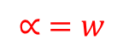
NOW THAT YOU MENTION IT…
$$z=w⋅\vec{x}+b$$
$$∝ =w$$

Slide 45
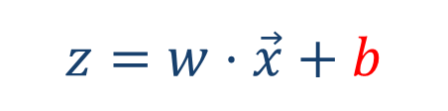
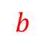
NOW THAT YOU MENTION IT…
$$z=w⋅\vec{x}+b$$
$$b$$

Slide 46
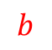
NOW THAT YOU MENTION IT…
$$z=w⋅\vec{x}+b$$
$$b$$

Slide 47
SIGMOID
81 values ($\vec{x}$)
…
…
1 | 0 | 0 | 0 | 0 | 0 | 0 | 0 | 0
0 | 1 | 0 | 0 | 0 | 0 | 1 | 0 | 0
0 | 0 | 1 | 0 | 0 | 1 | 0 | 0 | 0
0 | 0 | 0 | 1 | 1 | 0 | 0 | 0 | 0
0 | 0 | 0 | 1 | 1 | 0 | 0 | 0 | 0
0 | 0 | 1 | 0 | 0 | 1 | 0 | 0 | 0
0 | 1 | 0 | 0 | 0 | 0 | 1 | 0 | 0
0 | 0 | 0 | 0 | 0 | 0 | 1 | 0 | 0
0 | 0 | 0 | 0 | 0 | 0 | 0 | 0 | 0
9 pixels
Ʃ
Ʃ
9 pixels
823,731.01
14,78

Slide 48
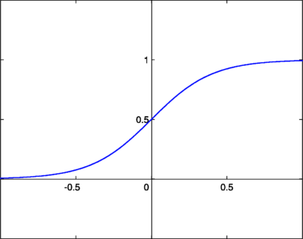
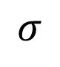
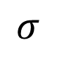
SIGMOID
81 values ($\vec{x}$)
…
…
1 | 0 | 0 | 0 | 0 | 0 | 0 | 0 | 0
0 | 1 | 0 | 0 | 0 | 0 | 1 | 0 | 0
0 | 0 | 1 | 0 | 0 | 1 | 0 | 0 | 0
0 | 0 | 0 | 1 | 1 | 0 | 0 | 0 | 0
0 | 0 | 0 | 1 | 1 | 0 | 0 | 0 | 0
0 | 0 | 1 | 0 | 0 | 1 | 0 | 0 | 0
0 | 1 | 0 | 0 | 0 | 0 | 1 | 0 | 0
0 | 0 | 0 | 0 | 0 | 0 | 1 | 0 | 0
0 | 0 | 0 | 0 | 0 | 0 | 0 | 0 | 0
9 pixels
Ʃ
Ʃ
9 pixels
$$σ$$
$$σ$$
0.78
0.32

Slide 49
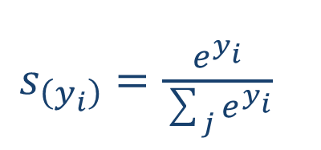
SOFTMAX
81 values ($\vec{x}$)
…
…
1 | 0 | 0 | 0 | 0 | 0 | 0 | 0 | 0
0 | 1 | 0 | 0 | 0 | 0 | 1 | 0 | 0
0 | 0 | 1 | 0 | 0 | 1 | 0 | 0 | 0
0 | 0 | 0 | 1 | 1 | 0 | 0 | 0 | 0
0 | 0 | 0 | 1 | 1 | 0 | 0 | 0 | 0
0 | 0 | 1 | 0 | 0 | 1 | 0 | 0 | 0
0 | 1 | 0 | 0 | 0 | 0 | 1 | 0 | 0
0 | 0 | 0 | 0 | 0 | 0 | 1 | 0 | 0
0 | 0 | 0 | 0 | 0 | 0 | 0 | 0 | 0
$s_{\left(y_{i}\right)}=\frac{ⅇ^{y_{i}}}{\sum_{j}{ⅇ^{y_{i}}}}$
9 pixels
Ʃ
Ʃ
9 pixels
0.75
0.25
These are actual probabilities

Slide 50
LOSS FUNCTION
One-hot encoding
1 | 0 | 0 | 0 | 0 | 0 | 0 | 0 | 0
0 | 1 | 0 | 0 | 0 | 0 | 1 | 0 | 0
0 | 0 | 1 | 0 | 0 | 1 | 0 | 0 | 0
0 | 0 | 0 | 1 | 1 | 0 | 0 | 0 | 0
0 | 0 | 0 | 1 | 1 | 0 | 0 | 0 | 0
0 | 0 | 1 | 0 | 0 | 1 | 0 | 0 | 0
0 | 1 | 0 | 0 | 0 | 0 | 1 | 0 | 0
0 | 0 | 0 | 0 | 0 | 0 | 1 | 0 | 0
0 | 0 | 0 | 0 | 0 | 0 | 0 | 0 | 0
1
0
9 pixels
9 pixels
0.75
0.25

Slide 51

LOSS FUNCTION
1 | 0 | 0 | 0 | 0 | 0 | 0 | 0 | 0
0 | 1 | 0 | 0 | 0 | 0 | 1 | 0 | 0
0 | 0 | 1 | 0 | 0 | 1 | 0 | 0 | 0
0 | 0 | 0 | 1 | 1 | 0 | 0 | 0 | 0
0 | 0 | 0 | 1 | 1 | 0 | 0 | 0 | 0
0 | 0 | 1 | 0 | 0 | 1 | 0 | 0 | 0
0 | 1 | 0 | 0 | 0 | 0 | 1 | 0 | 0
0 | 0 | 0 | 0 | 0 | 0 | 1 | 0 | 0
0 | 0 | 0 | 0 | 0 | 0 | 0 | 0 | 0
1
0
9 pixels
error =$\left(y_{j}−p_{j}\right)$
9 pixels
0.75
0.25

Slide 52
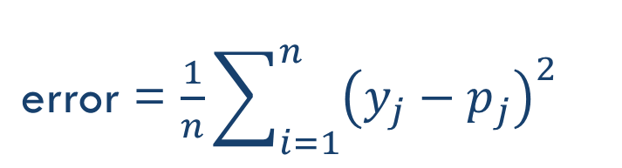
LOSS FUNCTION
1 | 0 | 0 | 0 | 0 | 0 | 0 | 0 | 0
0 | 1 | 0 | 0 | 0 | 0 | 1 | 0 | 0
0 | 0 | 1 | 0 | 0 | 1 | 0 | 0 | 0
0 | 0 | 0 | 1 | 1 | 0 | 0 | 0 | 0
0 | 0 | 0 | 1 | 1 | 0 | 0 | 0 | 0
0 | 0 | 1 | 0 | 0 | 1 | 0 | 0 | 0
0 | 1 | 0 | 0 | 0 | 0 | 1 | 0 | 0
0 | 0 | 0 | 0 | 0 | 0 | 1 | 0 | 0
0 | 0 | 0 | 0 | 0 | 0 | 0 | 0 | 0
1
0
9 pixels
error = $\frac{1}{n}\sum_{i=1}^{n}{{\left(y_{j}−p_{j}\right)}^{2}}$
9 pixels
0.75
0.25

Slide 53
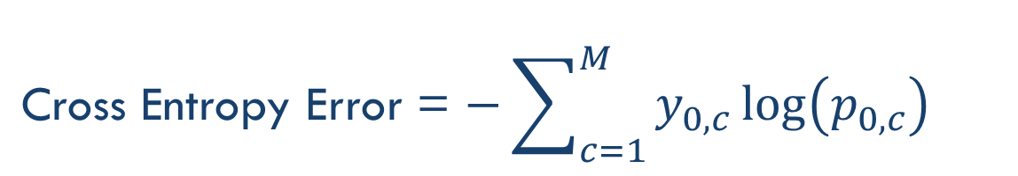
LOSS FUNCTION
1 | 0 | 0 | 0 | 0 | 0 | 0 | 0 | 0
0 | 1 | 0 | 0 | 0 | 0 | 1 | 0 | 0
0 | 0 | 1 | 0 | 0 | 1 | 0 | 0 | 0
0 | 0 | 0 | 1 | 1 | 0 | 0 | 0 | 0
0 | 0 | 0 | 1 | 1 | 0 | 0 | 0 | 0
0 | 0 | 1 | 0 | 0 | 1 | 0 | 0 | 0
0 | 1 | 0 | 0 | 0 | 0 | 1 | 0 | 0
0 | 0 | 0 | 0 | 0 | 0 | 1 | 0 | 0
0 | 0 | 0 | 0 | 0 | 0 | 0 | 0 | 0
1
0
9 pixels
Cross Entropy Error = $−\sum_{c=1}^{M}{{y_{0,c}\log\left(p_{0,c}\right)}^{}}$
9 pixels
Binary: −(y*log(p) + (1−y)*log(1−p))
0.75
0.25

Slide 54
TRAINING
x = vector of pixels (input)
x = vector of pixels (input)
…
…
…
…
…
…
…
…
…
…
…
…
…
…
…
…
…
…
…
…
…
…
…
…
.
.
.
.
.
.
.
.
z = times(x, W) + b
cross_entropy_with_softmax(z, y)
classification_error(z, y)
…
…
…
…
…
…
…
…
(1, 0)
(0, 1)
(1, 0)
y = label vector (one-hot)
Training Data

Slide 55
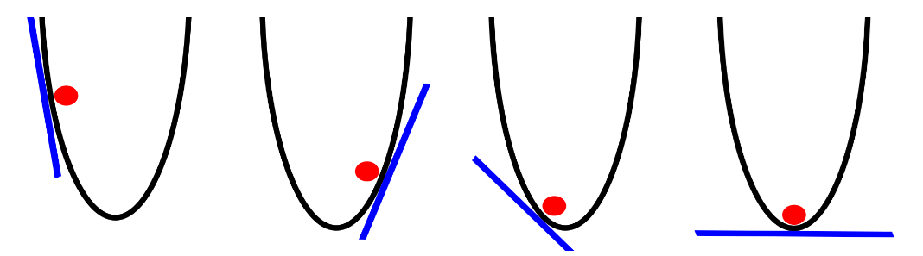
GRADIENT DESCENT

Slide 56
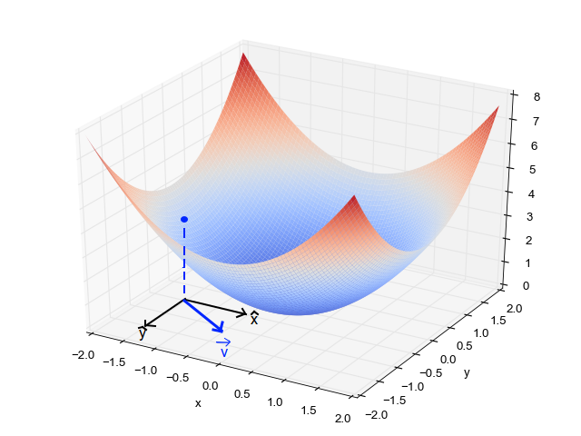
GRADIENT DESCENT

Slide 57
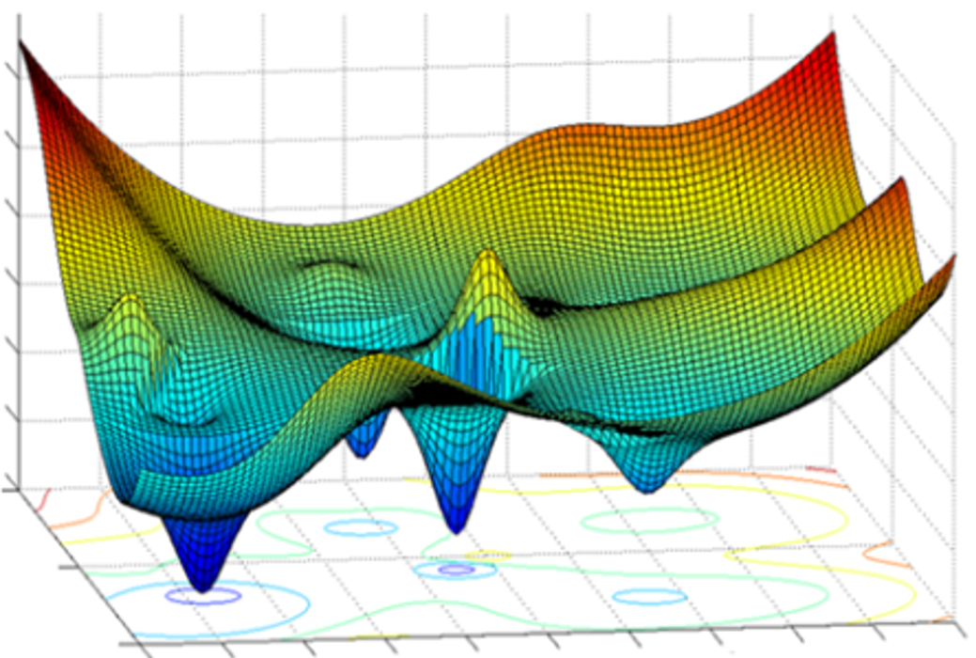
GRADIENT DESCENT

Slide 58
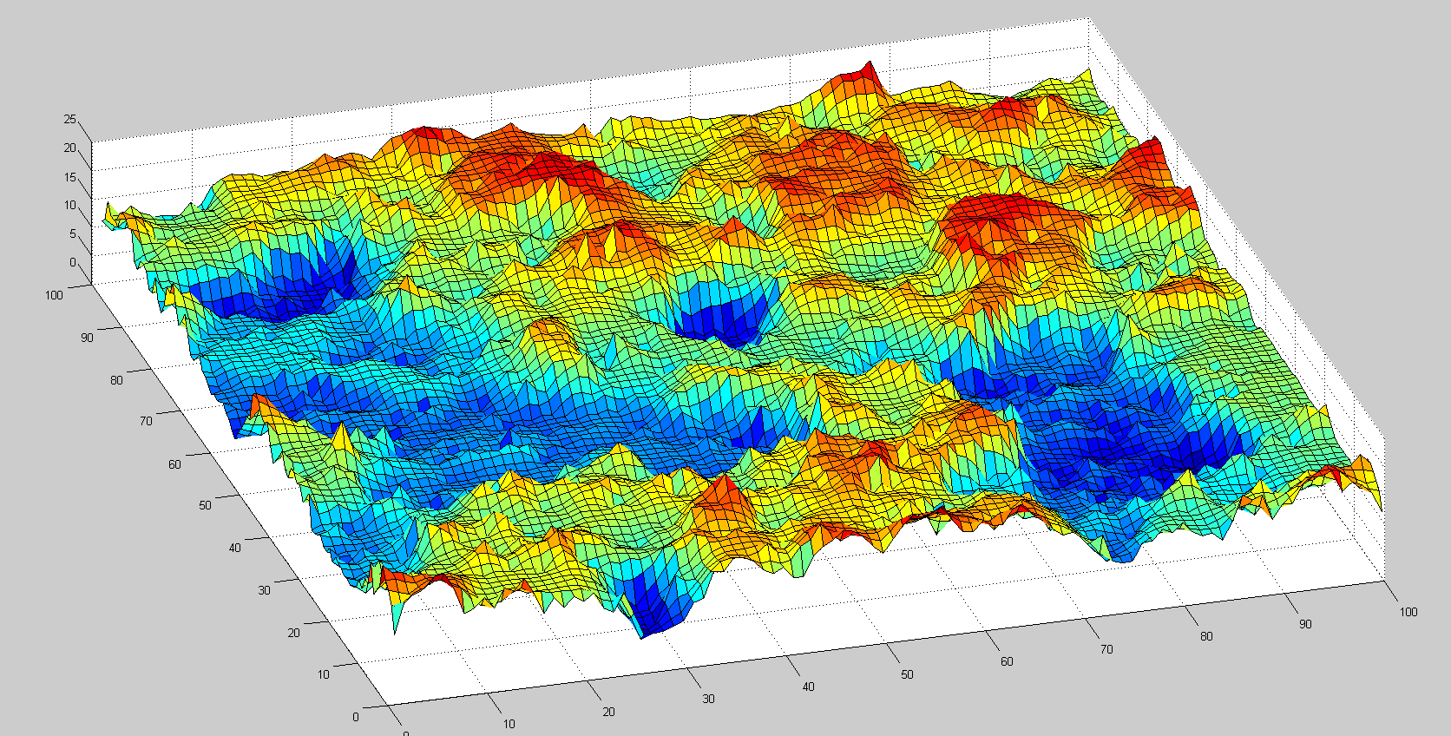
REMEMBER THIS?

Slide 59
LAB 2: Logistic Regression

Slide 60



Keras
Mission: to make building Deep architectures easier
Works on top of TensorFlow or Theano
Built by François Chollet at Google

Slide 61
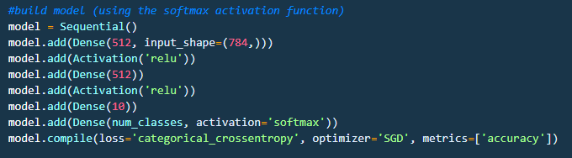
Keras
Based on layers and their input/output tensors

Slide 62
LAB 3: Logistic Regression (Keras)

Slide 63
Neural Networks

Slide 64
NEURAL NETWORK (CLASSIFIER)
Category 1
Category 2
Input Layer
Hidden Layers
Output Layer

Slide 65
NEURAL NETWORK (CLASSIFIER)
Category 1
Category 2
Input Layer
Hidden Layers
Output Layer

Slide 66
FORWARD PROPAGATION
Category 1
Category 2
Input Layer
Hidden Layers
Output Layer

Slide 67
FORWARD PROPAGATION
Category 1
Category 2
Input Layer
Hidden Layers
Output Layer

Slide 68
FORWARD PROPAGATION
Category 1
Category 2
Input Layer
Hidden Layers
Output Layer

Slide 69
FORWARD PROPAGATION
Category 1
Category 2
Input Layer
Hidden Layers
Output Layer

Slide 70
TRAINING
Cost = Generated Value – Ground Truth
Category 1
Category 2
Input Layer
Hidden Layers
Output Layer

Slide 71
BACKPROPAGATION
Cost = Generated Value – Ground Truth
Category 1
Error = X
Category 2
Input Layer
Hidden Layers
Output Layer

Slide 72
LAB 4: Multi-Layer Perceptron

Slide 73
Convolutional Networks

Slide 74
REMEMBER THIS THING?

Slide 75
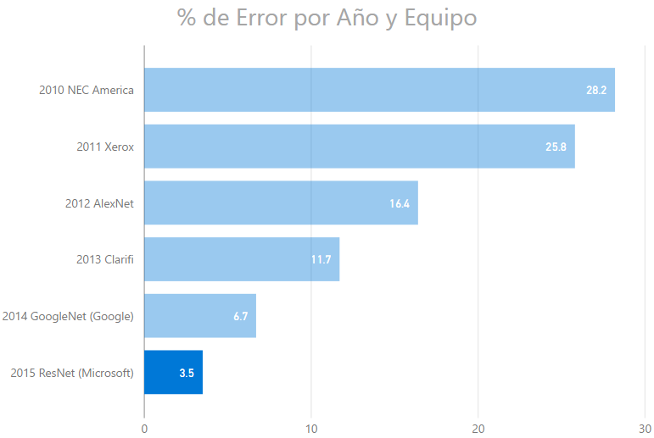
IMAGENET CHALLENGE (CLASSIFICATION)

Slide 76
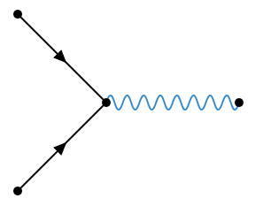
WHAT HAPPENED IN 2012?
DNNs
Deep Learning
GPUs
2012
t

Slide 77
FILTERING
0 | 0 | 0 | 0 | 0 | 0 | 0 | 0 | 0
0 | 1 | 0 | 0 | 0 | 0 | 0 | 1 | 0
0 | 0 | 1 | 0 | 0 | 0 | 1 | 0 | 0
0 | 0 | 0 | 1 | 0 | 1 | 0 | 0 | 0
0 | 0 | 0 | 0 | 1 | 0 | 0 | 0 | 0
0 | 0 | 0 | 1 | 0 | 1 | 0 | 0 | 0
0 | 0 | 1 | 0 | 0 | 0 | 1 | 0 | 0
0 | 1 | 0 | 0 | 0 | 0 | 0 | 1 | 0
0 | 0 | 0 | 0 | 0 | 0 | 0 | 0 | 0
0 | 0 | 0 | 0 | 0 | 0 | 0 | 0 | 0
0 | 0 | 0 | 0 | 0 | 0 | 1 | 0 | 0
0 | 1 | 0 | 0 | 0 | 1 | 0 | 0 | 0
0 | 0 | 1 | 1 | 0 | 1 | 0 | 0 | 0
0 | 0 | 0 | 0 | 1 | 0 | 0 | 0 | 0
0 | 0 | 0 | 1 | 0 | 1 | 1 | 0 | 0
0 | 0 | 0 | 1 | 0 | 0 | 0 | 1 | 0
0 | 0 | 1 | 0 | 0 | 0 | 0 | 0 | 0
0 | 0 | 0 | 0 | 0 | 0 | 0 | 0 | 0
0 | 0 | 0 | 0 | 0 | 0 | 0 | 0 | 0
0 | 0 | 0 | 0 | 0 | 0 | 1 | 0 | 0
0 | 1 | 0 | 0 | 0 | 1 | 0 | 0 | 0
0 | 0 | 1 | 1 | 0 | 1 | 0 | 0 | 0
0 | 0 | 0 | 0 | 1 | 0 | 0 | 0 | 0
0 | 0 | 0 | 1 | 0 | 1 | 1 | 0 | 0
0 | 0 | 0 | 1 | 0 | 0 | 0 | 1 | 0
0 | 0 | 1 | 0 | 0 | 0 | 0 | 0 | 0
0 | 0 | 0 | 0 | 0 | 0 | 0 | 0 | 0

Slide 78
FILTERING
…looking for common characteristics
Filter 1
Filter 2
Filter 3
1 | -1 | -1
-1 | 1 | -1
-1 | -1 | 1
-1 | -1 | 1
-1 | 1 | -1
1 | -1 | -1
1 | -1 | 1
-1 | 1 | -1
1 | -1 | 1
-1 | -1 | -1 | -1 | -1 | -1 | -1 | -1 | -1
-1 | 1 | -1 | -1 | -1 | -1 | -1 | 1 | -1
-1 | -1 | 1 | -1 | -1 | -1 | 1 | -1 | -1
-1 | -1 | -1 | 1 | -1 | 1 | -1 | -1 | -1
-1 | -1 | -1 | -1 | 1 | -1 | -1 | -1 | -1
-1 | -1 | -1 | 1 | -1 | 1 | -1 | -1 | -1
-1 | -1 | 1 | -1 | -1 | -1 | 1 | -1 | -1
-1 | 1 | -1 | -1 | -1 | -1 | -1 | 1 | -1
-1 | -1 | -1 | -1 | -1 | -1 | -1 | -1 | -1
1 | 1 | 1
1 | 1 | 1
1 | 1 | 1
-1 | 1 | -1
1 | 1 | 1
-1 | 1 | -1
1 | 1 | -1
1 | 1 | 1
-1 | 1 | 1
1.0
0.11
0.55

Slide 79
CONVOLUTION
Filter
-1 | -1 | -1 | -1 | -1 | -1 | -1 | -1 | -1
-1 | 1 | -1 | -1 | -1 | -1 | -1 | 1 | -1
-1 | -1 | 1 | -1 | -1 | -1 | 1 | -1 | -1
-1 | -1 | -1 | 1 | -1 | 1 | -1 | -1 | -1
-1 | -1 | -1 | -1 | 1 | -1 | -1 | -1 | -1
-1 | -1 | -1 | 1 | -1 | 1 | -1 | -1 | -1
-1 | -1 | 1 | -1 | -1 | -1 | 1 | -1 | -1
-1 | 1 | -1 | -1 | -1 | -1 | -1 | 1 | -1
-1 | -1 | -1 | -1 | -1 | -1 | -1 | -1 | -1
0.77 | -0.11 | 0.11 | 0.33 | 0.55 | -0.11 | 0.33
-0.11 | 1.00 | -0.11 | 0.33 | -0.11 | 0.11 | -0.11
0.11 | -0.11 | 1.00 | -0.33 | 0.11 | -0.11 | 0.55
0.33 | 0.33 | -0.33 | 0.55 | -0.33 | 0.33 | 0.33
0.55 | -0.11 | 0.11 | -0.33 | 1.00 | -0.11 | 0.11
-0.11 | 0.11 | -0.11 | 0.33 | -0.11 | 1.00 | -0.11
0.33 | -0.11 | 0.55 | 0.33 | 0.11 | -0.11 | 0.77
1 | -1 | -1
-1 | 1 | -1
-1 | -1 | 1

Slide 80

CONVOLUTION
-1 | -1 | -1 | -1 | -1 | -1 | -1 | -1 | -1
-1 | 1 | -1 | -1 | -1 | -1 | -1 | 1 | -1
-1 | -1 | 1 | -1 | -1 | -1 | 1 | -1 | -1
-1 | -1 | -1 | 1 | -1 | 1 | -1 | -1 | -1
-1 | -1 | -1 | -1 | 1 | -1 | -1 | -1 | -1
-1 | -1 | -1 | 1 | -1 | 1 | -1 | -1 | -1
-1 | -1 | 1 | -1 | -1 | -1 | 1 | -1 | -1
-1 | 1 | -1 | -1 | -1 | -1 | -1 | 1 | -1
-1 | -1 | -1 | -1 | -1 | -1 | -1 | -1 | -1
0.77 | -0.11 | 0.11 | 0.33 | 0.55 | -0.11 | 0.33
-0.11 | 1.00 | -0.11 | 0.33 | -0.11 | 0.11 | -0.11
0.11 | -0.11 | 1.00 | -0.33 | 0.11 | -0.11 | 0.55
0.33 | 0.33 | -0.33 | 0.55 | -0.33 | 0.33 | 0.33
0.55 | -0.11 | 0.11 | -0.33 | 1.00 | -0.11 | 0.11
-0.11 | 0.11 | -0.11 | 0.33 | -0.11 | 1.00 | -0.11
0.33 | -0.11 | 0.55 | 0.33 | 0.11 | -0.11 | 0.77
$$⊗$$
=
1 | -1 | -1
-1 | 1 | -1
-1 | -1 | 1

Slide 81


CONVOLUTION
-1 | -1 | -1 | -1 | -1 | -1 | -1 | -1 | -1
-1 | 1 | -1 | -1 | -1 | -1 | -1 | 1 | -1
-1 | -1 | 1 | -1 | -1 | -1 | 1 | -1 | -1
-1 | -1 | -1 | 1 | -1 | 1 | -1 | -1 | -1
-1 | -1 | -1 | -1 | 1 | -1 | -1 | -1 | -1
-1 | -1 | -1 | 1 | -1 | 1 | -1 | -1 | -1
-1 | -1 | 1 | -1 | -1 | -1 | 1 | -1 | -1
-1 | 1 | -1 | -1 | -1 | -1 | -1 | 1 | -1
-1 | -1 | -1 | -1 | -1 | -1 | -1 | -1 | -1
0.77 | -0.11 | 0.11 | 0.33 | 0.55 | -0.11 | 0.33
-0.11 | 1.00 | -0.11 | 0.33 | -0.11 | 0.11 | -0.11
0.11 | -0.11 | 1.00 | -0.33 | 0.11 | -0.11 | 0.55
0.33 | 0.33 | -0.33 | 0.55 | -0.33 | 0.33 | 0.33
0.55 | -0.11 | 0.11 | -0.33 | 1.00 | -0.11 | 0.11
-0.11 | 0.11 | -0.11 | 0.33 | -0.11 | 1.00 | -0.11
0.33 | -0.11 | 0.55 | 0.33 | 0.11 | -0.11 | 0.77
$$⊗$$
=
1 | -1 | -1
-1 | 1 | -1
-1 | -1 | 1
-1 | -1 | -1 | -1 | -1 | -1 | -1 | -1 | -1
-1 | 1 | -1 | -1 | -1 | -1 | -1 | 1 | -1
-1 | -1 | 1 | -1 | -1 | -1 | 1 | -1 | -1
-1 | -1 | -1 | 1 | -1 | 1 | -1 | -1 | -1
-1 | -1 | -1 | -1 | 1 | -1 | -1 | -1 | -1
-1 | -1 | -1 | 1 | -1 | 1 | -1 | -1 | -1
-1 | -1 | 1 | -1 | -1 | -1 | 1 | -1 | -1
-1 | 1 | -1 | -1 | -1 | -1 | -1 | 1 | -1
-1 | -1 | -1 | -1 | -1 | -1 | -1 | -1 | -1
$$⊗$$
0.33 | -0.11 | 0.55 | 0.33 | 0.11 | -0.11 | 0.77
-0.11 | 0.11 | -0.11 | 0.33 | -0.11 | 1.00 | -0.11
0.55 | -0.11 | 0.11 | -0.33 | 1.00 | -0.11 | 0.11
0.33 | 0.33 | -0.33 | 0.55 | -0.33 | 0.33 | 0.33
0.11 | -0.11 | 1.00 | -0.33 | 0.11 | -0.11 | 0.55
-0.11 | 1.00 | -0.11 | 0.33 | -0.11 | 0.11 | -0.11
0.77 | -0.11 | 0.11 | 0.33 | 0.55 | -0.11 | 0.33
=
-1 | -1 | 1
-1 | 1 | -1
1 | -1 | -1

Slide 82

0.77 | -0.11 | 0.11 | 0.33 | 0.55 | -0.11 | 0.33
-0.11 | 1.00 | -0.11 | 0.33 | -0.11 | 0.11 | -0.11
0.11 | -0.11 | 1.00 | -0.33 | 0.11 | -0.11 | 0.55
0.33 | 0.33 | -0.33 | 0.55 | -0.33 | 0.33 | 0.33
0.55 | -0.11 | 0.11 | -0.33 | 1.00 | -0.11 | 0.11
-0.11 | 0.11 | -0.11 | 0.33 | -0.11 | 1.00 | -0.11
0.33 | -0.11 | 0.55 | 0.33 | 0.11 | -0.11 | 0.77
1 | -1 | -1
-1 | 1 | -1
-1 | -1 | 1
-1 | -1 | -1 | -1 | -1 | -1 | -1 | -1 | -1
-1 | 1 | -1 | -1 | -1 | -1 | -1 | 1 | -1
-1 | -1 | 1 | -1 | -1 | -1 | 1 | -1 | -1
-1 | -1 | -1 | 1 | -1 | 1 | -1 | -1 | -1
-1 | -1 | -1 | -1 | 1 | -1 | -1 | -1 | -1
-1 | -1 | -1 | 1 | -1 | 1 | -1 | -1 | -1
-1 | -1 | 1 | -1 | -1 | -1 | 1 | -1 | -1
-1 | 1 | -1 | -1 | -1 | -1 | -1 | 1 | -1
-1 | -1 | -1 | -1 | -1 | -1 | -1 | -1 | -1
$$⊗$$
=
0.33 | -0.55 | -0.11 | -0.11 | 0.11 | -0.55 | 0.33
-0.55 | 0.55 | -0.55 | 0.33 | -0.55 | 0.55 | -0.55
0.11 | -0.55 | 0.55 | -0.77 | 0.55 | -0.55 | 0.11
-0.11 | 0.33 | -0.77 | 1.00 | -0.77 | 0.33 | -0.11
0.11 | -0.55 | 0.55 | -0.77 | 0.55 | -0.55 | 0.11
-0.55 | 0.55 | -0.55 | 0.33 | -0.55 | 0.55 | -0.55
0.33 | -0.55 | 0.11 | -0.11 | 0.11 | -0.55 | 0.33
1 | -1 | 1
-1 | 1 | -1
1 | -1 | 1
0.33 | -0.11 | 0.55 | 0.33 | 0.11 | -0.11 | 0.77
-0.11 | 0.11 | -0.11 | 0.33 | -0.11 | 1.00 | -0.11
0.55 | -0.11 | 0.11 | -0.33 | 1.00 | -0.11 | 0.11
0.33 | 0.33 | -0.33 | 0.55 | -0.33 | 0.33 | 0.33
0.11 | -0.11 | 1.00 | -0.33 | 0.11 | -0.11 | 0.55
-0.11 | 1.00 | -0.11 | 0.33 | -0.11 | 0.11 | -0.11
0.77 | -0.11 | 0.11 | 0.33 | 0.55 | -0.11 | 0.33
-1 | -1 | 1
-1 | 1 | -1
1 | -1 | -1

Slide 83



STRIDES AND PADDING
source: https://github.com/vdumoulin/conv_arithmetic

Slide 84
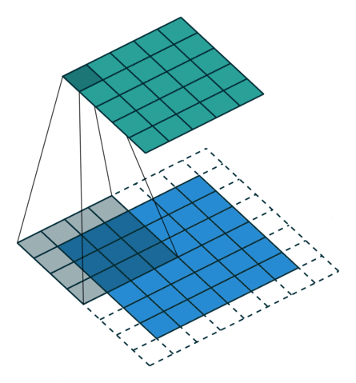

DECONVOLUTION – TRANSPOSED CONVOLUTION
source: https://github.com/vdumoulin/conv_arithmetic

Slide 85
POOLING
0.77 | -0.11 | 0.11 | 0.33 | 0.55 | -0.11 | 0.33
-0.11 | 1.00 | -0.11 | 0.33 | -0.11 | 0.11 | -0.11
0.11 | -0.11 | 1.00 | -0.33 | 0.11 | -0.11 | 0.55
0.33 | 0.33 | -0.33 | 0.55 | -0.33 | 0.33 | 0.33
0.55 | -0.11 | 0.11 | -0.33 | 1.00 | -0.11 | 0.11
-0.11 | 0.11 | -0.11 | 0.33 | -0.11 | 1.00 | -0.11
0.33 | -0.11 | 0.55 | 0.33 | 0.11 | -0.11 | 0.77

Slide 86
POOLING
0.77 | -0.11 | 0.11 | 0.33 | 0.55 | -0.11 | 0.33
-0.11 | 1.00 | -0.11 | 0.33 | -0.11 | 0.11 | -0.11
0.11 | -0.11 | 1.00 | -0.33 | 0.11 | -0.11 | 0.55
0.33 | 0.33 | -0.33 | 0.55 | -0.33 | 0.33 | 0.33
0.55 | -0.11 | 0.11 | -0.33 | 1.00 | -0.11 | 0.11
-0.11 | 0.11 | -0.11 | 0.33 | -0.11 | 1.00 | -0.11
0.33 | -0.11 | 0.55 | 0.33 | 0.11 | -0.11 | 0.77

Slide 87
AVERAGE POOLING – STRIDE 1
0.77 | -0.11 | 0.11 | 0.33 | 0.55 | -0.11 | 0.33
-0.11 | 1.00 | -0.11 | 0.33 | -0.11 | 0.11 | -0.11
0.11 | -0.11 | 1.00 | -0.33 | 0.11 | -0.11 | 0.55
0.33 | 0.33 | -0.33 | 0.55 | -0.33 | 0.33 | 0.33
0.55 | -0.11 | 0.11 | -0.33 | 1.00 | -0.11 | 0.11
-0.11 | 0.11 | -0.11 | 0.33 | -0.11 | 1.00 | -0.11
0.33 | -0.11 | 0.55 | 0.33 | 0.11 | -0.11 | 0.77
0.39 | 0.22 | 0.17 | 0.28 | 0.11 | 0.06
0.22 | 0.45 | 0.22 | 0.00 | 0.00 | 0.11
0.17 | 0.22 | 0.22 | 0.00 | 0.00 | 0.28
0.28 | 0.00 | 0.00 | 0.22 | 0.22 | 0.17
0.11 | 0.00 | 0.00 | 0.22 | 0.45 | 0.22
0.06 | 0.11 | 0.28 | 0.17 | 0.22 | 0.39

Slide 88
MAX POOLING – STRIDE 1
0.77 | -0.11 | 0.11 | 0.33 | 0.55 | -0.11 | 0.33
-0.11 | 1.00 | -0.11 | 0.33 | -0.11 | 0.11 | -0.11
0.11 | -0.11 | 1.00 | -0.33 | 0.11 | -0.11 | 0.55
0.33 | 0.33 | -0.33 | 0.55 | -0.33 | 0.33 | 0.33
0.55 | -0.11 | 0.11 | -0.33 | 1.00 | -0.11 | 0.11
-0.11 | 0.11 | -0.11 | 0.33 | -0.11 | 1.00 | -0.11
0.33 | -0.11 | 0.55 | 0.33 | 0.11 | -0.11 | 0.77
1.00 | 1.00 | 0.33 | 0.55 | 0.55 | 0.33
1.00 | 1.00 | 1.00 | 0.33 | 0.11 | 0.55
0.33 | 1.00 | 1.00 | 0.55 | 0.33 | 0.55
0.55 | 0.33 | 0.55 | 1.00 | 1.00 | 0.33
0.55 | 0.11 | 0.33 | 1.00 | 1.00 | 1.00
0.33 | 0.55 | 0.55 | 0.33 | 1.00 | 1.00

Slide 89
AVERAGE POOLING – STRIDE 2
0.77 | -0.11 | 0.11 | 0.33 | 0.55 | -0.11 | 0.33
-0.11 | 1.00 | -0.11 | 0.33 | -0.11 | 0.11 | -0.11
0.11 | -0.11 | 1.00 | -0.33 | 0.11 | -0.11 | 0.55
0.33 | 0.33 | -0.33 | 0.55 | -0.33 | 0.33 | 0.33
0.55 | -0.11 | 0.11 | -0.33 | 1.00 | -0.11 | 0.11
-0.11 | 0.11 | -0.11 | 0.33 | -0.11 | 1.00 | -0.11
0.33 | -0.11 | 0.55 | 0.33 | 0.11 | -0.11 | 0.77
1.00 | 0.33 | 0.55 | 0.33
0.33 | 1.00 | 0.33 | 0.55
0.55 | 0.33 | 1.00 | 0.11
0.33 | 0.55 | 0.11 | 0.77

Slide 90
WHY POOLING?

Slide 91
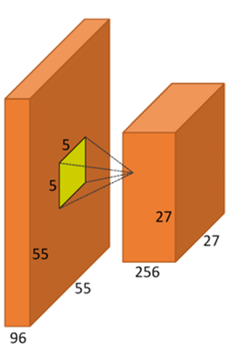
ACTIVATION FUNCTIONS?

Slide 92
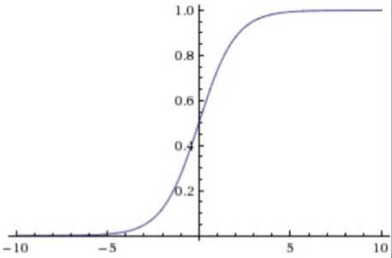
ACTIVATION FUNCTIONS?
LOGISTIC FUNCTION (“sigmoid”):
Simple
Drawbacks:
Saturates
Non-centered in zero
We don’t use it anymore, but we thank her for the services provided to the cause :)

Slide 93

ACTIVATION FUNCTIONS?
HYPERBOLIC TANGENT (tanh):
Solves the issue with not being centered in zero
Still ‘killing gradients’ due to saturating behaviouir
It is always better than the logistic function

Slide 94

ACTIVATION FUNCTIONS?
RECTIFIED LINEAR UNITS (ReLU):
Optimization for the SGD convergence
More simple from a computational point of view
Fragile

Slide 95

ACTIVATION FUNCTIONS?
LEAKY ReLU:
More stable than traditional ReLu
Particular case of MaxOut

Slide 96

ACTIVATION FUNCTIONS?
SWISH:
Self-Gating activation function
Better performance than ReLu

Slide 97
RECTIFIED LINEAR UNITS (ReLU)
0.77 | -0.11 | 0.11 | 0.33 | 0.55 | -0.11 | 0.33
-0.11 | 1.00 | -0.11 | 0.33 | -0.11 | 0.11 | -0.11
0.11 | -0.11 | 1.00 | -0.33 | 0.11 | -0.11 | 0.55
0.33 | 0.33 | -0.33 | 0.55 | -0.33 | 0.33 | 0.33
0.55 | -0.11 | 0.11 | -0.33 | 1.00 | -0.11 | 0.11
-0.11 | 0.11 | -0.11 | 0.33 | -0.11 | 1.00 | -0.11
0.33 | -0.11 | 0.55 | 0.33 | 0.11 | -0.11 | 0.77
0.77 | 0.00 | 0.11 | 0.33 | 0.55 | 0.00 | 0.33
0.00 | 1.00 | 0.00 | 0.33 | 0.00 | 0.11 | 0.00
0.11 | 0.00 | 1.00 | 0.00 | 0.11 | 0.00 | 0.55
0.33 | 0.33 | 0.00 | 0.55 | 0.00 | 0.33 | 0.33
0.55 | 0.00 | 0.11 | 0.00 | 1.00 | 0.00 | 0.11
0.00 | 0.11 | 0.00 | 0.33 | 0.00 | 1.00 | 0.00
0.33 | 0.00 | 0.55 | 0.33 | 0.11 | 0.00 | 0.77

Slide 98

DROPOUT

Slide 99

DROPOUT

Slide 100
WHAT IS MISSING?
Filter 1
Filter 2
Filter 3
1 | -1 | -1
-1 | 1 | -1
-1 | -1 | 1
-1 | -1 | 1
-1 | 1 | -1
1 | -1 | -1
1 | -1 | 1
-1 | 1 | -1
1 | -1 | 1
How have these filters been selected/created?

Slide 101
AlexNet

Slide 102
HOW A CNN SEES

Slide 103
HOW A CNN SEES

Slide 104

HOW A CNN SEES

Slide 105

HOW A CNN SEES

Slide 106

HOW A CNN SEES

Slide 107

HOW A CNN SEES

Slide 108

HOW A CNN SEES

Slide 109


Slide 110
LAB 5: Convolutional Networks

Slide 111
Autoencoders

Slide 112




BASIC AUTOENCODER
$$\hat{x}=h_{W,b}≈x$$

Slide 113
Recurrent Neural Networks

Slide 114


HANDLING SEQUENCES

Slide 115

TRACKING THE HISTORY

Slide 116

RECURRENCE

Slide 117


Slide 118

LONG SHORT TERM MEMORY

Slide 119


Slide 120


Slide 121


Slide 122


Slide 123
Some Advanced Ideas

Slide 124

Counting people in a multitude
CONTEXTUAL PYRAMID CNN (CP-CNN)
A new method named Contextual Pyramid CNN (CP-CNN) is proposed here to generate density maps and influx estimations, by explicitely incorporating global and local context information. Composed of four modules: Global Context Estimator (GCE), Local Context Estimator (LCE), Density Map Estimator (DME) and a Fusion-CNN (F-CNN) convolutional network.
Vishwanath A. Sindagi, Vishal M. Patel; The IEEE International Conference on Computer Vision (ICCV), 2017, pp. 1861-1870

Slide 125


Slide 126


Slide 127


Slide 128
Transferring style between images
CONVOLUTIONAL NEURAL NETWORKS
By using a perceptual loss functions based on high-level features extracted from pretrained networks, networks for image transformation tasks can be trained, and by fine tuning the loss function different features can be kept for the source image and the style image.
Justin Johnson, Alexandre Alahi, Li Fei-Fei; Perceptual Losses for Real-Time Style Transfer and Super-Resolution, 2016

Slide 129


Slide 130



Slide 131


Slide 132

Using GANs to drive design decisions
GENERATIVE ADVERSARIAL NETWORKS
By taking advantage of Generational Adversarial Networks, synthetic images based on the training data can be generated. Including an external array of features, the generated images can be tailored to a specific set of requirements.
Jaime Deverall, Jiwoo Lee, Miguel Ayala; Using Generative Adversarial Networks to Design Shoes

Slide 133


Slide 134


Slide 135


Slide 136

HOW DOES THIS WORK?

Slide 137


MOVING FAST!

Slide 138

MOVING FAST!

Slide 139
SOME INTERESTING PAPERS
“ImageNet Classification with Deep Convolutional Neural Netowrks”
[Krizhevsky, Sutskever, Hinton]
http://www.cs.toronto.edu/~fritz/absps/imagenet.pdf
“Visualizing and Understanding Convolutional Networks”
[Zeiler, Fergus]
arXiv: 1311.2901v3
“Optimization Methods for Large-Scale Machine Learning”
[Bottou, Curtis, Nocedal]
arXiv: 1606.04838v2

Slide 140
SOME INTERESTING PAPERS
“Swish: A Self-Gated Activation Function”
[Ramachandran, Zoph, Quoc V.]
arXiv: 1710.05941v2
“Dynamic Routing Between Capsules”
[Sabour, Frosst, Hinton]
arXiv: 1710.09829

